Slide 1

Chapter 25
Utilizing Web Storage

Slide 2
Learning Objectives
How to create, store, retrieve, and delete cookies using JavaScript
How to store and retrieve session-based data using the sessionStorage object and increase the amount of data stored
How to store and retrieve long-term data using the localStorage object

Slide 3
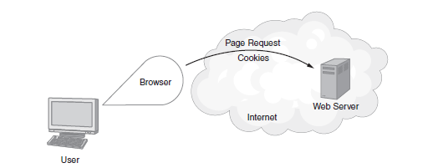
Data Storage the Old-Fashioned Way
For years Web developers made use of temporary storage locations called cookies, which reside on your disk.
The cookie-based storage is temporary in that you can delete the cookies or an application can delete cookies that it previously created.
A cookie is domain dependent, meaning, it relates to a specific site.
When you later visit that site and request a page, your browser will send the related cookies, too.

Slide 4
Creating a cookie
<!DOCTYPE html> <html> <head> <script> function CreateCookie() { varCookieExpirationDate = new Date(); var Days = 10; CookieExpirationDate.setDate(CookieExpirationDate.getDate() + Days); document.cookie="FirstCookie" + "=" + escape("Chapter 25") + ";expires="+CookieExpirationDate.toUTCString(); alert('Created the cookie: FirstCookie with the value Chapter 25'); } </script> </head> <body onload="CreateCookie()"> </body> </html>

Slide 5
ShowCookie
<!DOCTYPE html> <html> <head> <script> function CookieOperations() { CreateCookie(); DisplayCookie(); } function DisplayCookie() { varCookieArray = document.cookie.split(";"); var value, name; for (i=0; i<CookieArray.length; i++) { name = CookieArray[i].substr(0,CookieArray[i].indexOf("=")); value = CookieArray[i].substr(CookieArray[i].indexOf("=")+1); while (name.indexOf(' ') == 0) // delete leading spaces name = name.substr(1); if (name == 'FirstCookie') alert('Retrieved cookie, FirstCookie, Value: ' +value); } } function CreateCookie() { varCookieExpirationDate = new Date(); var Days = 10; CookieExpirationDate.setDate(CookieExpirationDate.getDate() + Days); document.cookie="FirstCookie" + "=" + escape("Chapter 25") + ";expires="+CookieExpirationDate.toUTCString(); alert('Created the cookie: FirstCookie with the value Chapter 25'); } </script> </head> <body onload="CookieOperations()"> </body> </html>

Slide 6
Understanding HTML 5 Sessions
A session, with respect to a browser, is the period during which you have a window open on a specific domain, such as www.yahoo.com. If you close the window or move to a new domain, the session ends. Session data, therefore, is data that exists during a browser session.
To store temporary data within HTML 5, your pages use JavaScript to access the sessionStorage object. To determine if a browser supports the HTML storage capabilities, your code can test whether or not the window.sessionStorage object is defined.

Slide 7
Checking browser support for session variables
<!DOCTYPE html> <html> <head> <script> function CheckStorage() { if (window.sessionStorage != null) alert("Storage supported"); else alert("Storage not supported"); } </script> </head> <body onload="CheckStorage()"> </body> </html>

Slide 8
Storing a session variable
To store data using the sessionStorage object, use the setItem method to specify a lookup key and a value:
sessionStorage.LookupKey = “Data Value”;
For example, the following entry creates a key called UserVisit and assigns the current date to the key:
sessionStorage.UserVisit= new Date().toDateString();

Slide 9
Storing a form value in a session variable
<!DOCTYPE html> <html> <head> <script> function StoreName(name) { if (window.sessionStorage != null) { window.sessionStorage.Name = name; alert('Stored the name: ' + sessionStorage.Name); } else alert("Storage not supported"); } </script> </head> <body> Name: <input id="nameField" type="text"></input> <button onclick="StoreName(document.getElementById('nameField').value)">Store Name</button> <button onclick="alert('The stored name: ' + sessionStorage.Name);">Show Name</button></body> </html>

Slide 10
Storing multiple values
<!DOCTYPE html> <html> <head> <script> function StoreInfo(name) { if (window.sessionStorage != null) { window.sessionStorage.Name = document.getElementById('nameField').value; window.sessionStorage.Age = document.getElementById('ageField').value; window.sessionStorage.Phone = document.getElementById('phoneField').value; window.sessionStorage.Email = document.getElementById('emailField').value; } else alert("Storage not supported"); }

Slide 11
Storing multiple values continued
function ShowInfo() { alert(sessionStorage.Name + ' ' + sessionStorage.Age + ' ' + sessionStorage.Phone + ' ' + sessionStorage.Email); } </script> </head> <body> Name: <input id="nameField" type="text"></input><br/> Age: <input id="ageField" type="text"></input><br/> Phone: <input id="phoneField" type="text"></input><br/> Email: <input id="emailField" type="text"></input><br/> <button onclick="StoreInfo()">Store Data</button> <button onclick="ShowInfo();">Show Info</button> </body> </html>

Slide 12
Clearing Data from the Session Storage
The browser’s session data is lost when closing the browser window or moving it to a different domain.
The application can call the removeItem function to clear one item, or it can use the clear function to remove all of its session variables.
<button onclick="sessionStorage.clear();">Clear Info</button>

Slide 13
Storing Long-Term Data
There may be times, such as if you have an e-commerce shopping cart, when you will want to keep data from one user session to the next.
In such cases, your pages should use the localStorage object.
The use of the localStorage object is identical to that of the sessionStorage object, with the exception that the data you store persists until it is deleted.
function StoreName(name)
{
if (window.localStorage != null)
{
window.localStorage.Name = name;
alert('Stored the name: ' + localStorage.Name);
}
else
alert("Storage not supported");
}

Slide 14
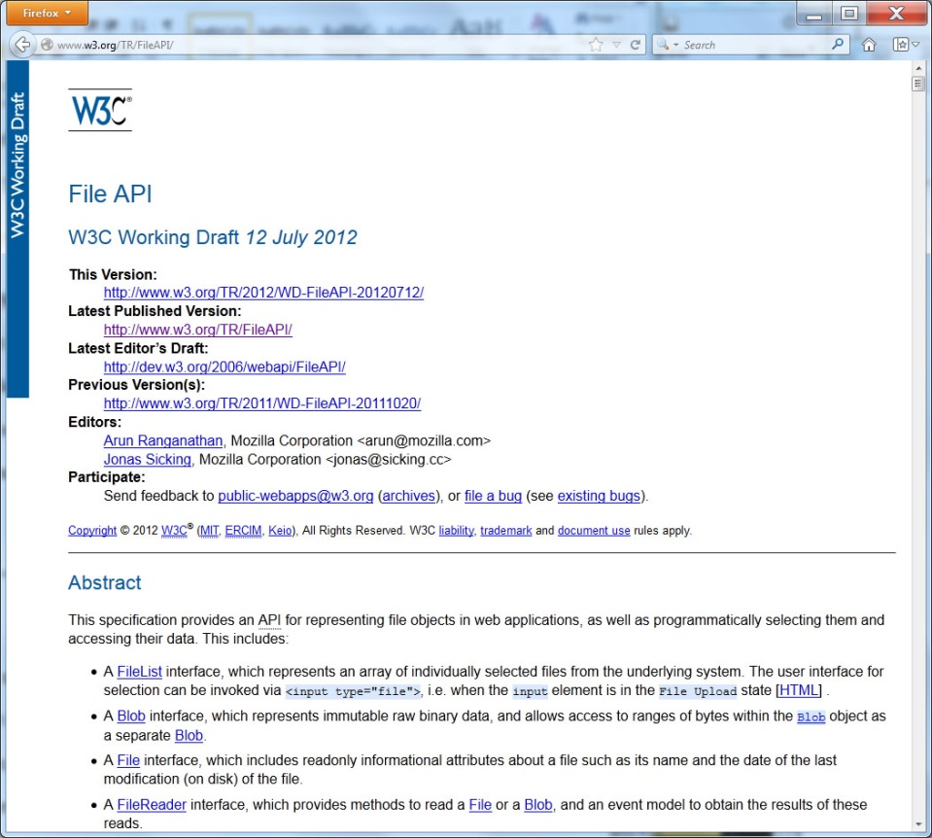
Real World design – File API

Slide 15
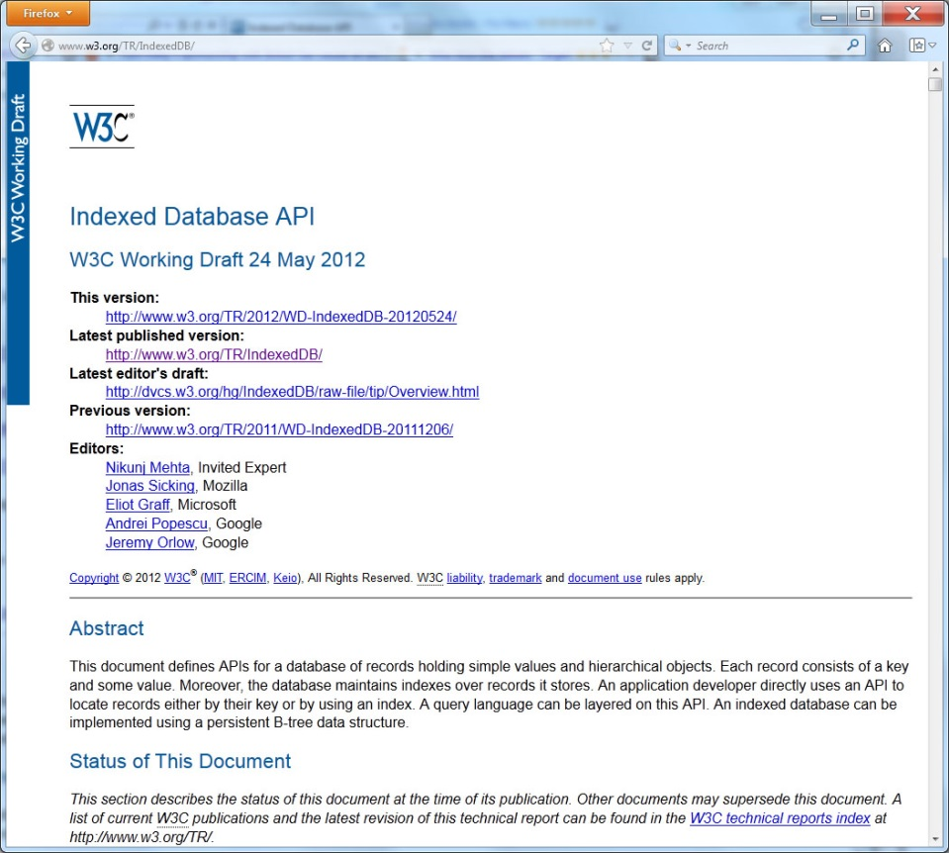
Real world Design – Indexed Database API

Slide 16
summary
For years, developers made extensive use of cookies to store temporary data on a user’s system. Using a cookie, an application can store up to 4KB of data. When you later visit a website and request a page, the browser sends any related cookies to the site.
To simplify client-side data storage operations and increase the amount of data an application can store, HTML provides a session-based storage object and a long-term storage object.
A session is the period of time when you interact with a site. If you close the browser window or move to a new site, the session ends. Using the sessionStorage object, applications can store session-based data.
In a similar way, the localStorage object lets you store data from one session to the next. Data you store using the localStorage object remains on the system until you or the application delete the data.
Using the sessionStorage and localStorage objects, your applications can store up to 5MB of data. If you need to store more data than that, consider using the File API or IndexedDB database API.

